Slide 1


Slide 2
NORTH MATRA ENVIRONMENTAL PROTECTION ASSOCIATION - HU exhibition

Slide 3
EXHIBITION ABOUT RECYCLING
Teaching students to recycle, and why recycling is so important!!
In order to conserve a clean beautiful earth to live in it is very important to begin teaching students at a young age the importance of recycling. Students are like sponges and observe information well if they learn about it starting at their early childhood education and throughout their school years. Students should learn about the causes and effects of recycling and from there teach their families of the importance of it if their families don’t contribute to recycling themselves. They need to know why recycling will conserve a better earth to live in.

Slide 4
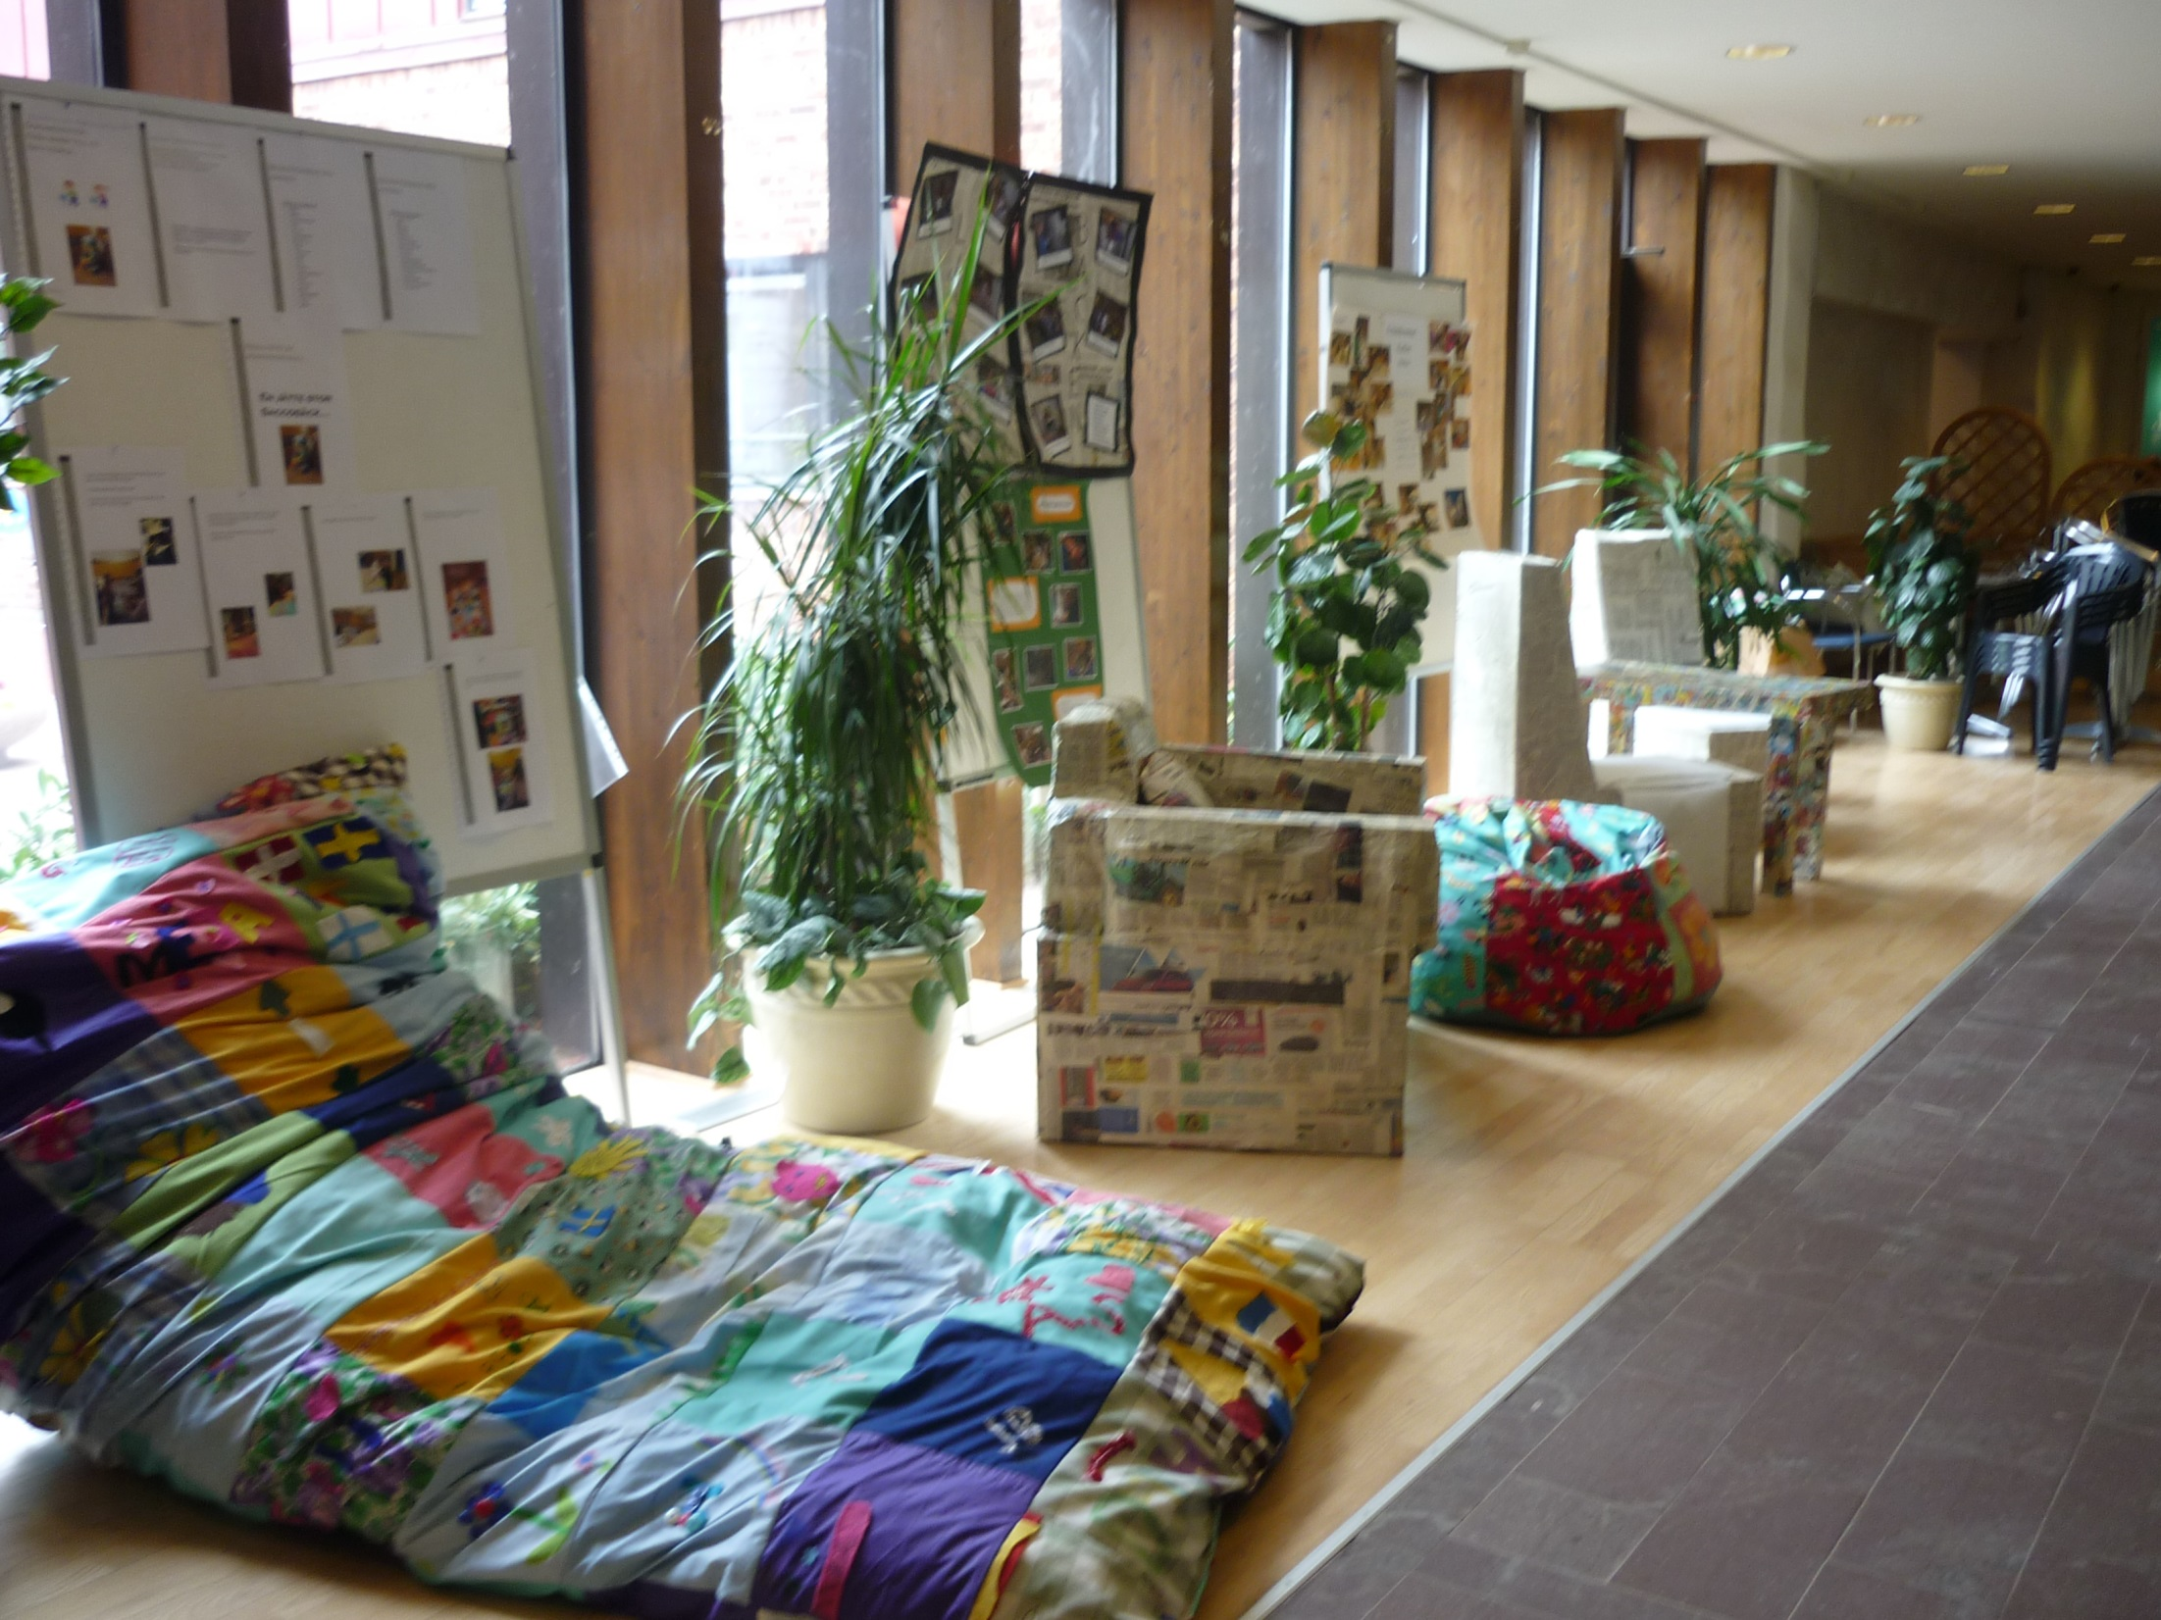
RECYCLING IN HOUSE

Slide 5
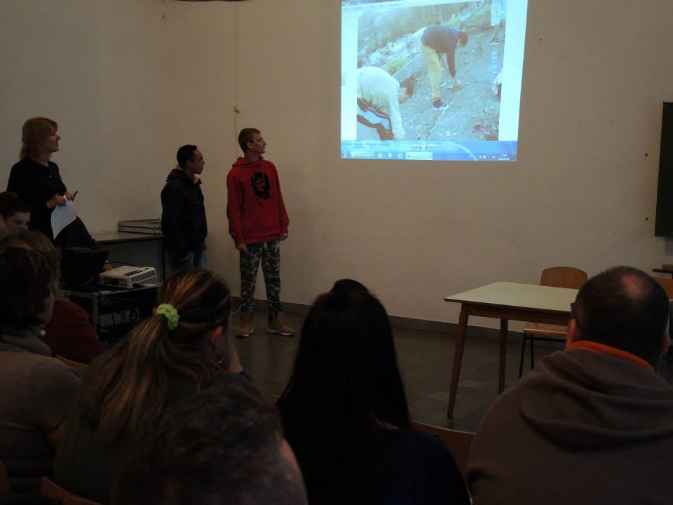
Composting is the use of vegetable waste

Slide 6
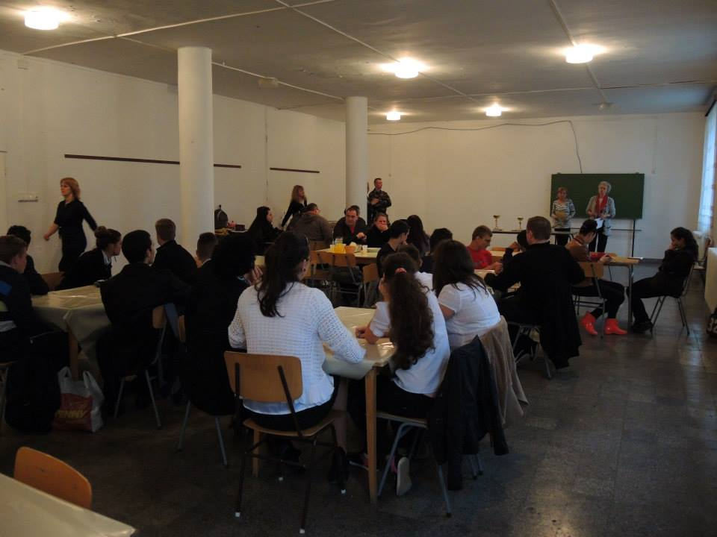
Discussion and group work in school

Slide 7
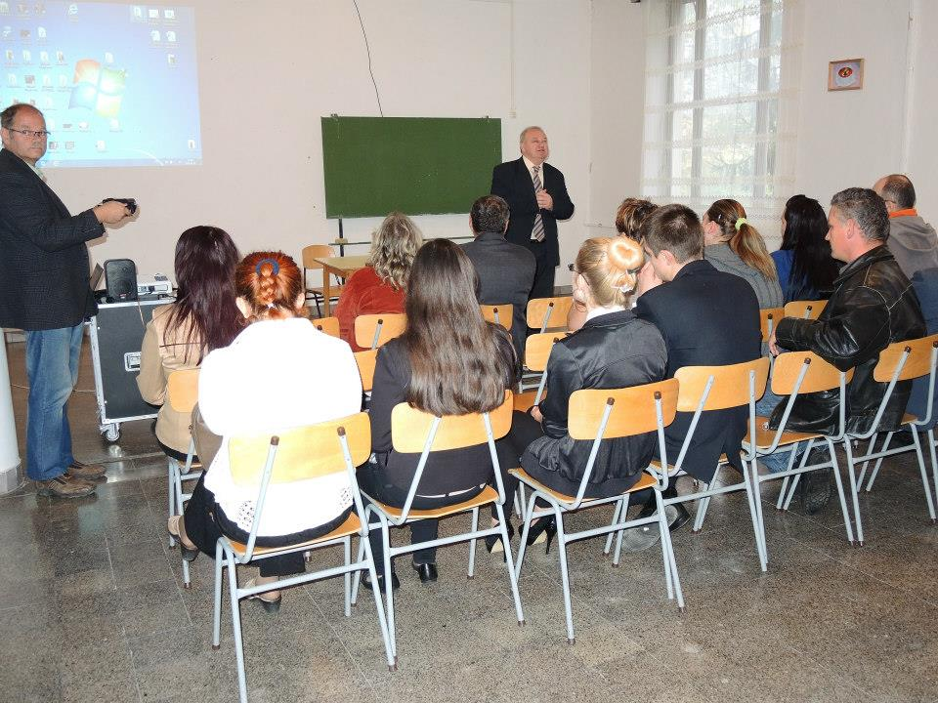
Presentation

Slide 8
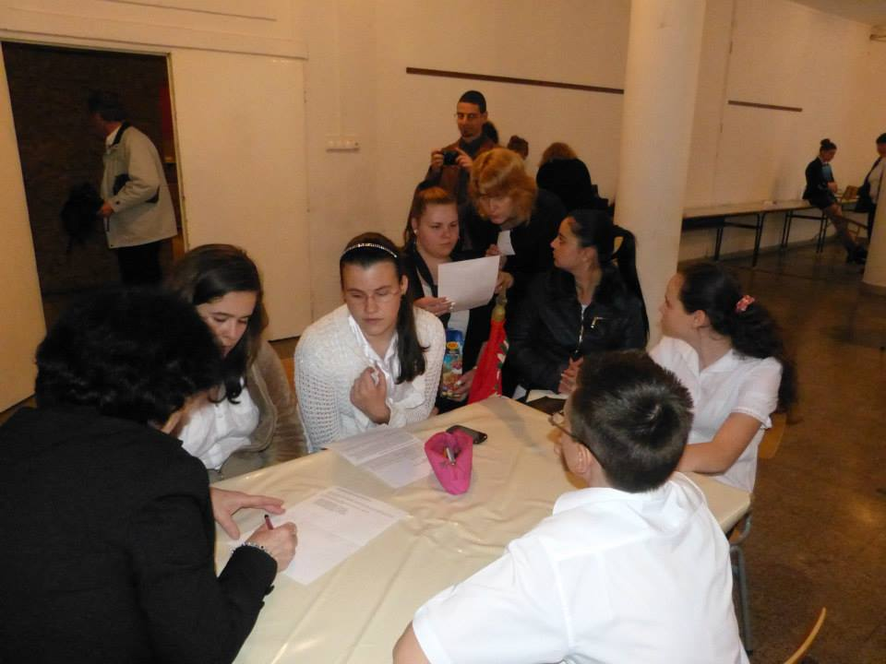
Quiz about recycling

Slide 9
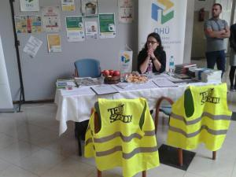
Exhibition

Slide 10
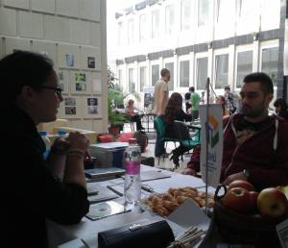
exhibition

